Slide 1
Assignment of Techfnatic
Sourajit Dey
Phone number-9614220401
Email id-sourajitdey35@gmail.com

Slide 2

Line Detection Text Detection Object detection

Slide 3
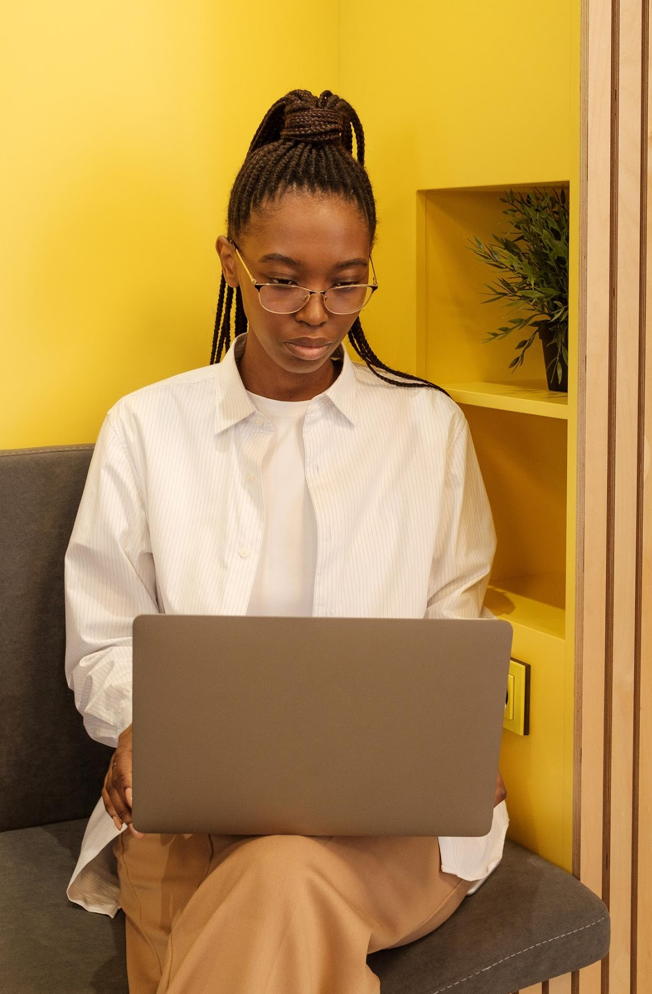
Objective
Line detection using HoughLinesP.
Text detection using pytesseract
Object detection using YOLO V5 .

Slide 4

Idea which I want to impliment for the task
Line detection
For line detection I used HoughLinesP opencv library.i am getting good result in HoughLinesP as compare to HoughLines .
Text detection
For text detection the most accurate was pytesseract library from python.although the text is not visible in last 3 or 4 images but I got good result using pytesseract.
Object detection
Object detecton I used YOLO V5 model the data is very less for train but I did data agmentation and improve the accuracy littlebit .

Slide 5
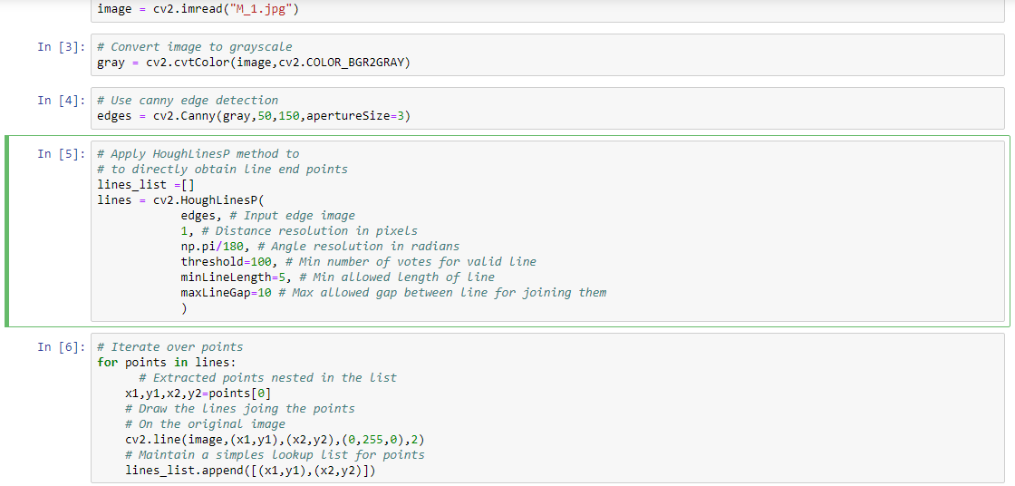
HoughLinesP code
Read the image
Converting the image to the gray scale image using cvtcolor method in cv2
Find out the edges(canny edges detection)
Argument of Houghlinesp
Image
Rho
Theta
Threshold
Minlinelenth
Maxlinegap

Slide 6
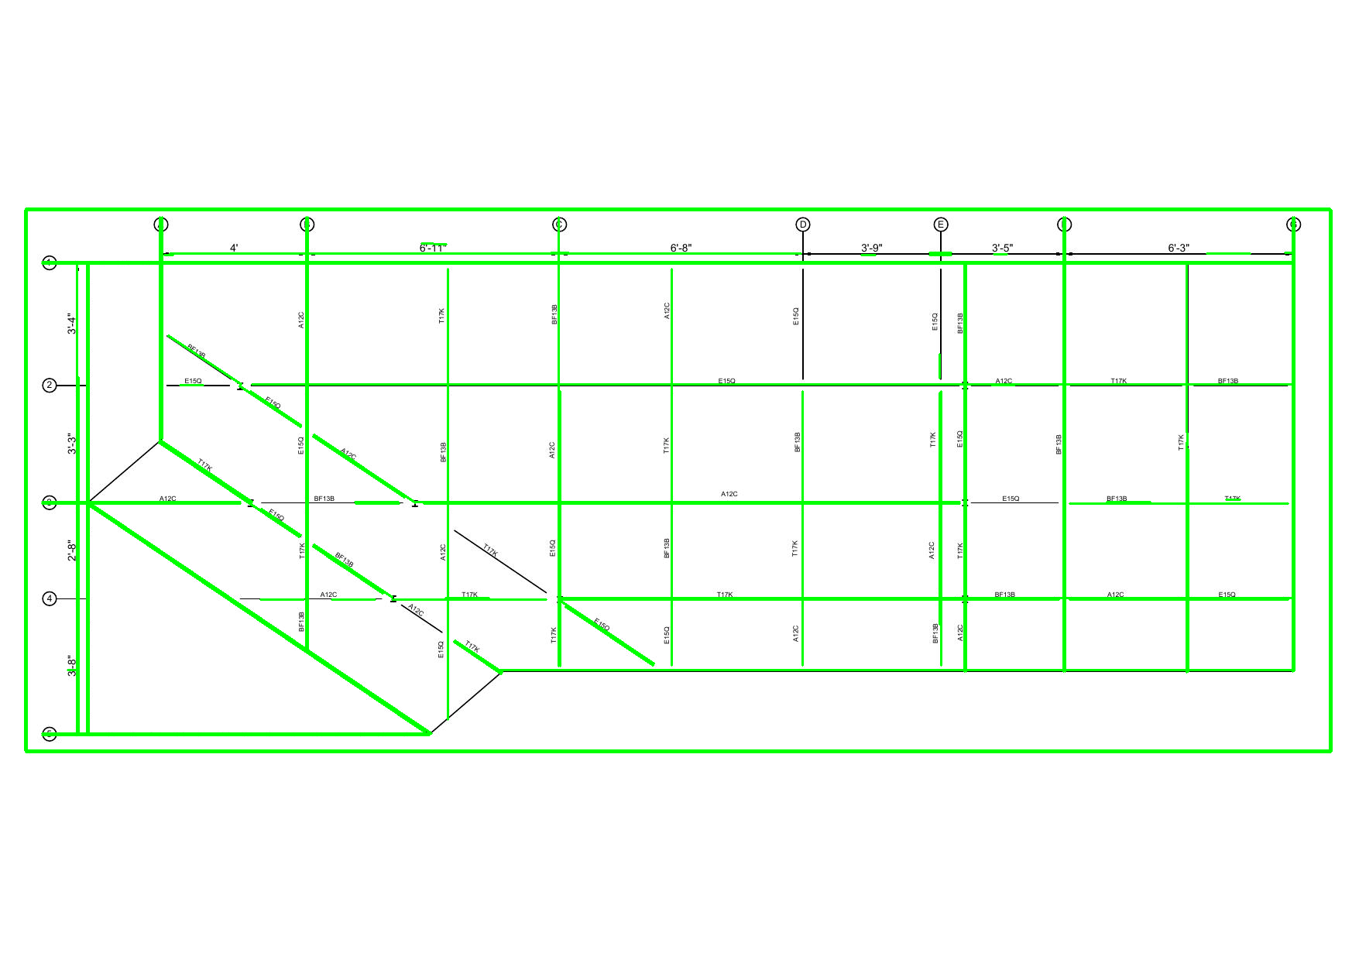
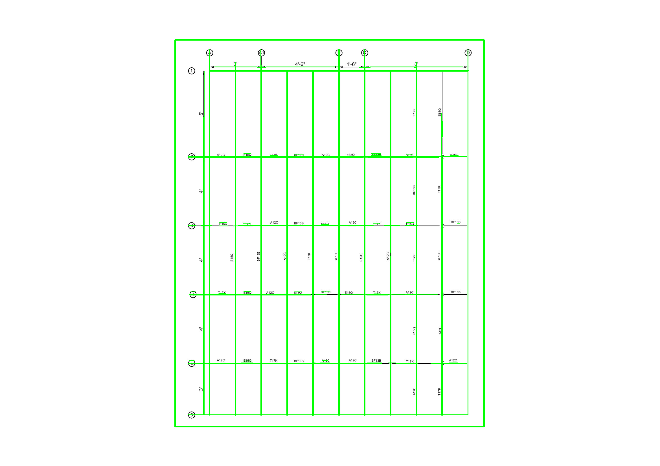
Output

Slide 7
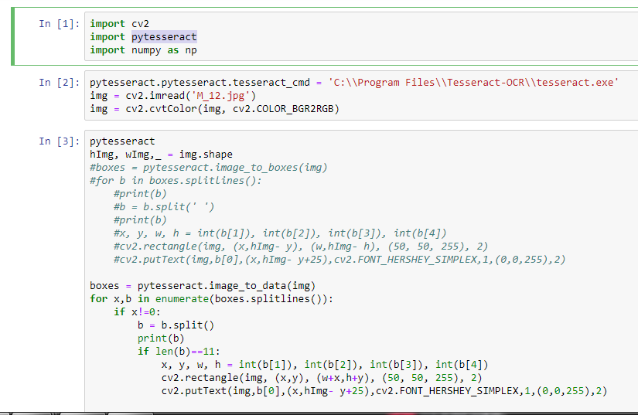
Pytesseract Code
Import cv2 pytesseract and numpy
Refer exc file of tesseract
Read the image and converted the image into gray
Used image-to-boxes function and store in a list
Crate a rectangle
And define a color (red)

Slide 8
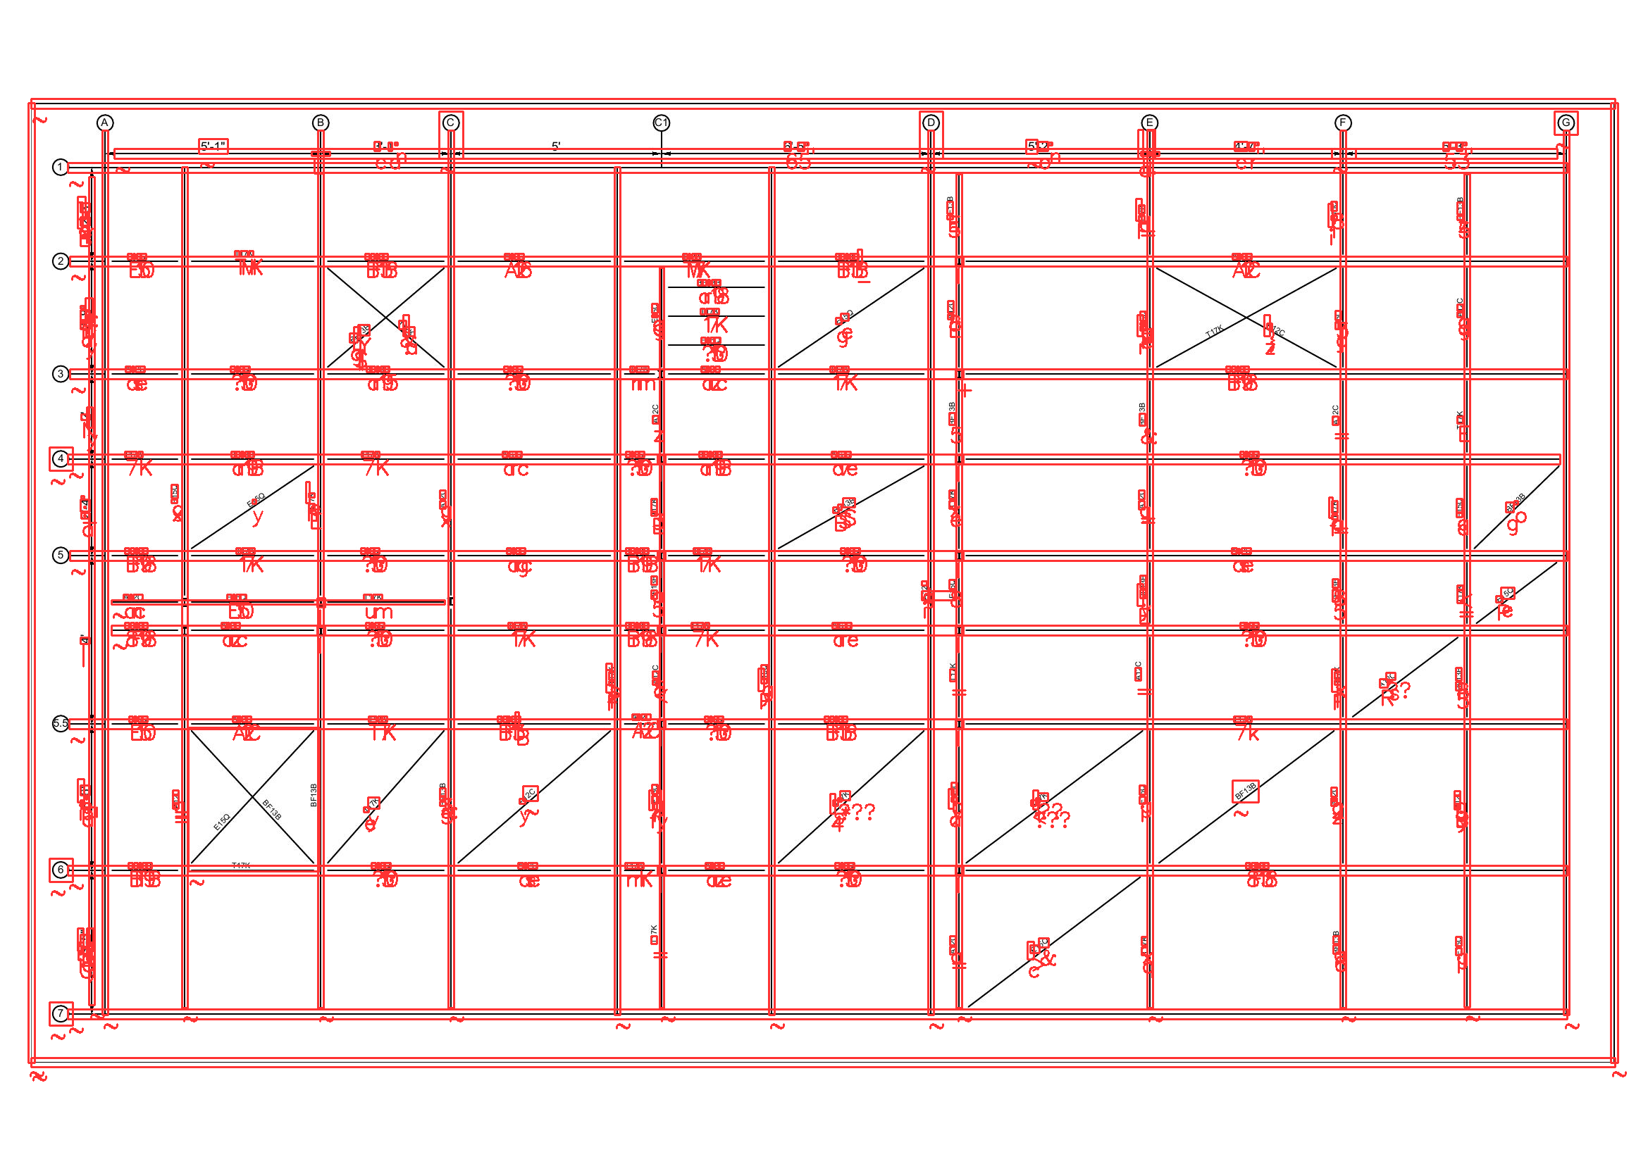
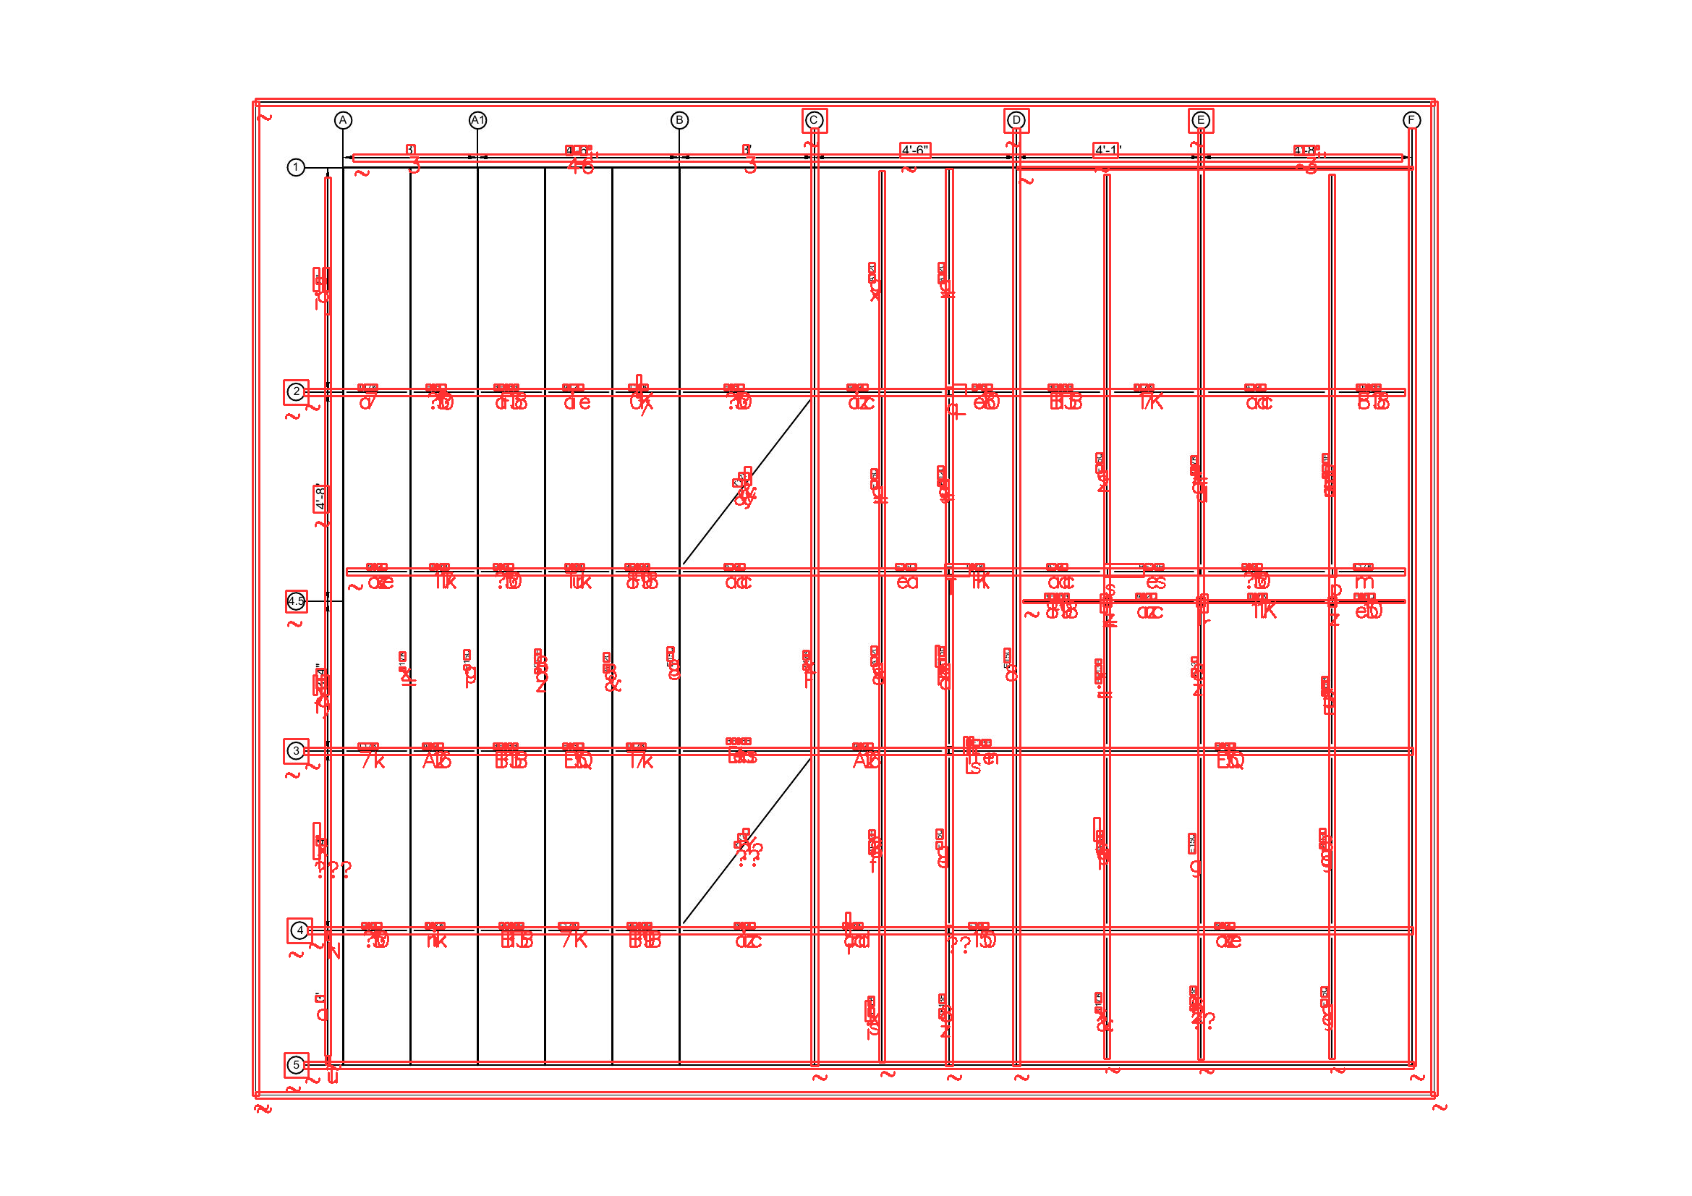
Output

Slide 9


labeling ,Data augmentation,YOLO train
All the step
Data augmentation
Train and validation
2
Data is very less for YOLOV5 model so I did some data augmention method like rotated the image clockwise and labeling all the rotated images
4
Training YOLO V5 model
I split the data set into train and validation.8 image for train folder and 4 for validation
Train the model I set the batch size is 60 and epoch is 1000.
1
3
5
Labeling
For labeling I used a website www.makesense.ai and labeling all the train images and val images
Upload data and modified Yolo file
I uploaded the zip dataset into the collab and modified the COCO128.yaml

Slide 10
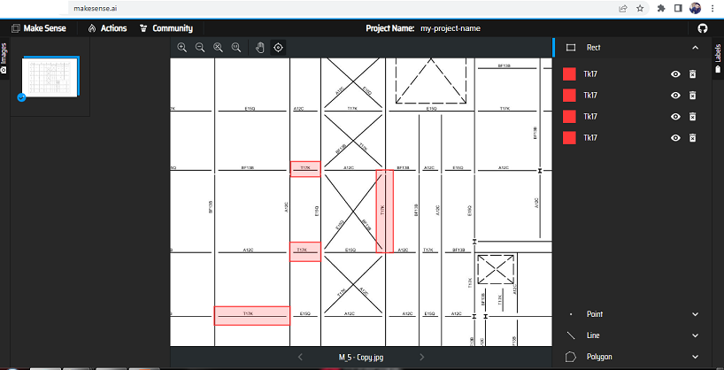
Labeling

Slide 11
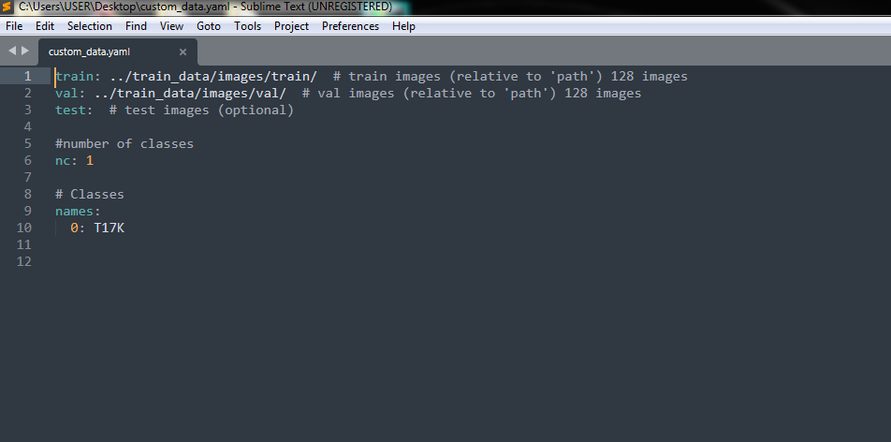
Modified coco128.yml file

Slide 12
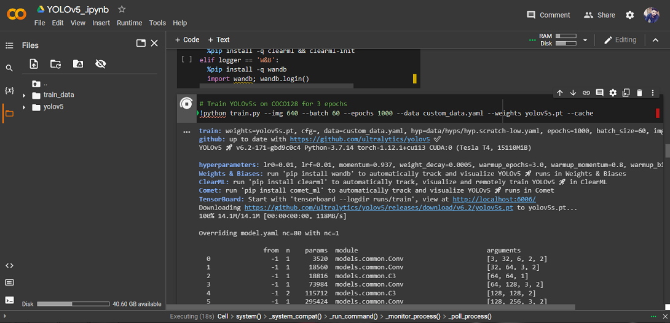
Train the YOLO model

Slide 13
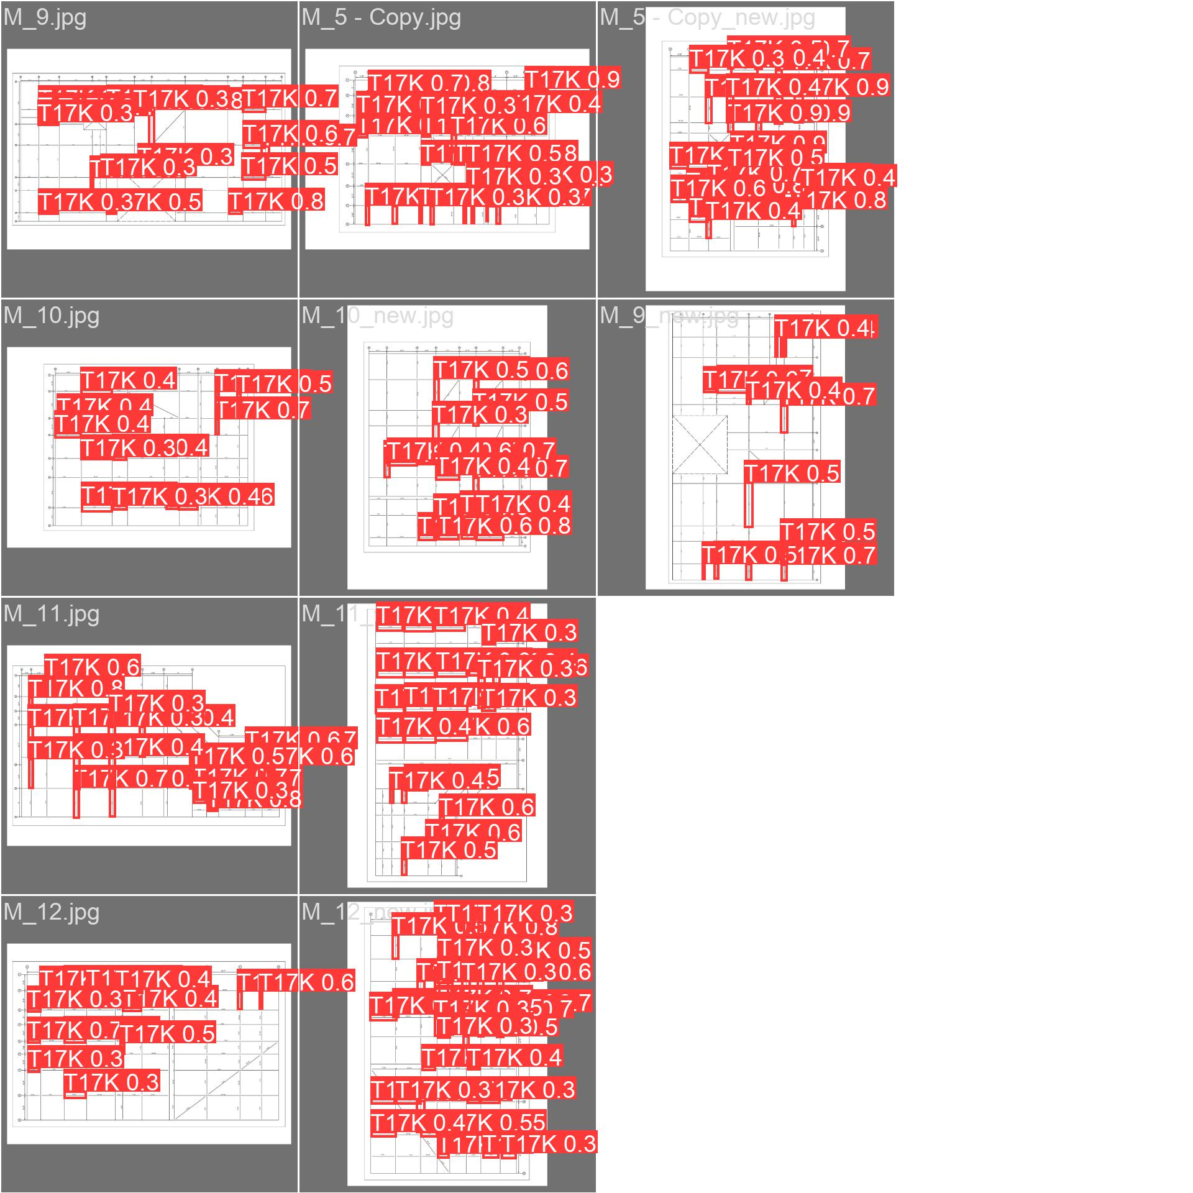
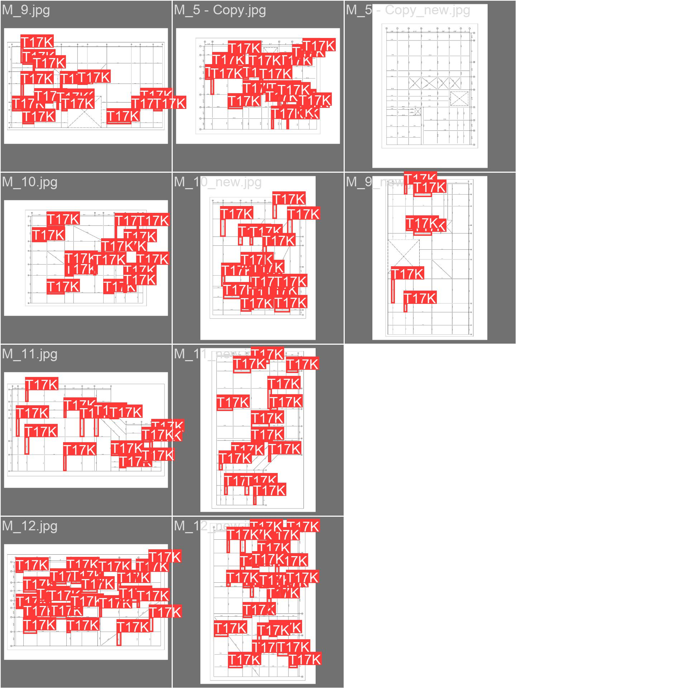
Output

Slide 14
Thank you!

